Slide 1
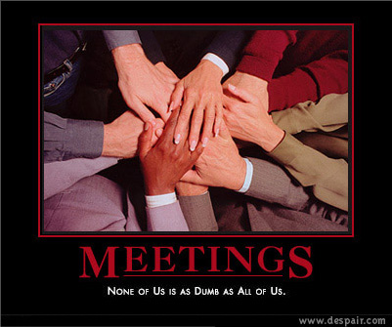
Project Porcupine
A few years ago, I had the idea that our community work together to build a game.
It was a terrible idea.

Slide 2
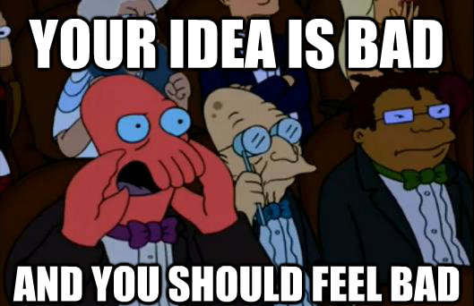
Design By Committee
Pro:
Everyone has ideas.
Con:
Everyone has ideas.

Slide 3
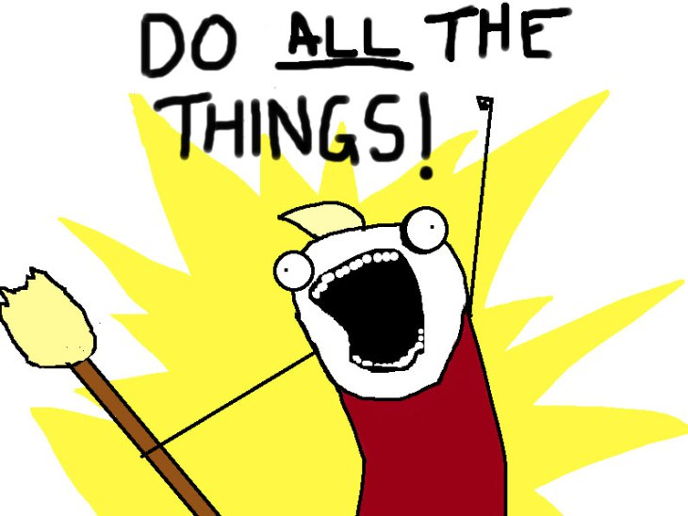
What's the problem?
The “Bazaar” model of development works when:
Scope is limited.
&
There's a clear goal.
…neither is true in the early days of
developing a game!

Slide 4
Open Source != Communal Dev
Most (or all?) of the great Open Source projects that I can think of have an official dev team.
Outside contribution can then be clear in scope:
- Bug Reports!
- Focused Patches!
- Improved Graphics/Tilesets!
- Designing a new monster/item and providing flavour text!

Slide 5
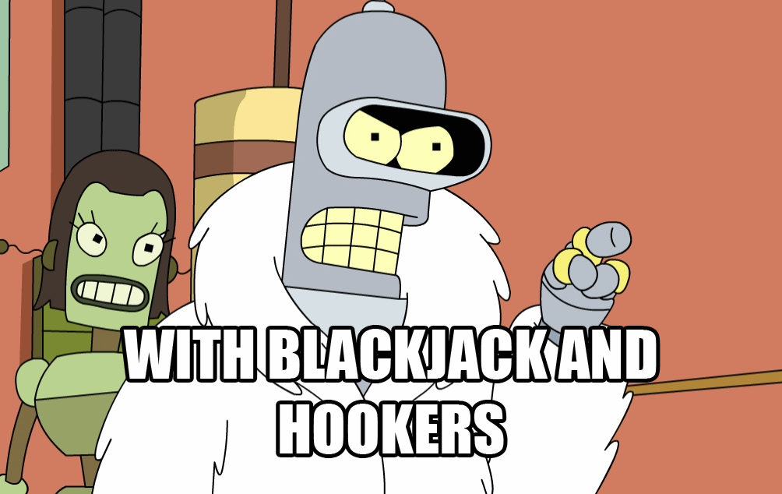
Go Fork Yourself
The true beauty of open source is that if something really isn't working, someone can just fork the project and start their own version.

Slide 6
The Plan
Project Porcupine (Mark II?) will be a:
2d Tile-Based (Single Level)
Base Building Game
With a “Space Station” theme.
Game Inspirations: Rimworld, Dwarf Fortress, Space Station 13
Media Inspirations: Deep Space 9, Firefly, Honorverse, The Martian.

Slide 7
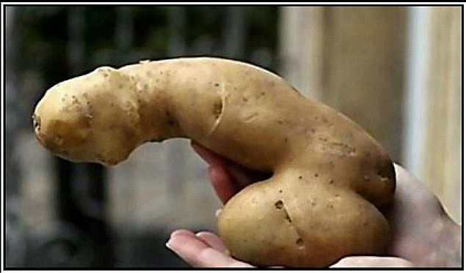
I'm the Dictator
To avoid falling into the trap of last time, I'm going to start the project entirely on my own. I'm going to set the “Phase One” feature list and be responsible for implementing most/all of it. The creation process will be published via video and livestreams (though likely not every step).

Slide 8
Phase One
2d Tile Map
Data Model
View/Render
Our “tiles” don't really have a type because we don't have base terrain.
Direct Build
Mouse place tiles (Floor, Wall, and Door). Doors are tiles, because they are structural and affect walkability.
Map save/load
Job System
No more direct placement. Mouse queues a building job.
AI Character
Grab job from queue, walk to spot, perform “work” and then the tile appears.
Ignores pathing for now.
Pathfinding
Can no longer walk through walls.
A*
Objects
Tiles can contain one object
Some objects can be “installed”, others are “loose”
Some objects are stackable.

Slide 9
Phase One (cont.)
Resources
Construction now requires materials. Characters need to bring material to the job site, then complete it.
Rooms
Detect if an area is completely enclosed.
Atmosphere
Rooms track air pressure and gas %, equalize with neighbours. Track if “vacuum”.
N & O2 generators, CO2 scrubbers.
Breathing
Characters have a small internal air reserve (lungs/suit) and convert O2 to CO2.
If in sufficient air pressure, will exchange air with room.
Doors
Characters must wait for a door to open before walking through it.
Airlocks
You can define a room to be an airlock, at which point it takes control of attached doors, automating the pressurizing/depressurizing of the room as character try to enter/leave.

Slide 10
Future Phases
Just a very early concept of what the roadmap could look like.
Expanded Resources:Power Generation, Food, Water, and more accounting for O2, N, and CO2. A mining drone launcher that periodically returns with building materials.
Standard of Living: Aeroponics, food variety, and cooking. Beds.
Specialized Fabrication: Raw “metal” will no longer be used for construction. Instead, machining shops will have to be setup to produce things like metal sheets, ceramacrete blocks, transparent aluminium, and fibre optic cable. Jobs now have categories and characters can have those categories enabled/disabled/prioritized.
No Longer Alone: Build a docking port to have freighters come by to trade. Some will be miners, looking to sell raw goods. Others will be colonists looking to settle down on a nearby planet and very interested in tools and finished supplies and food.
Danger, Will Robinson: Asteroids and space debris will occasionally impact the station, requiring repairs. Different types of walls are now available so that more expensive & durable walls can be built on the outside hull. Automated laser turrets can be built to help shoot down asteroids, though they often come in clusters and it's unlikely to be feasible to shoot them all.
Space Pirates: Enemy ships will engage your laser turrets, then will attempt to land at your docking port and board your ship. Character combat is introduced.

Slide 11
Definitions
Tile: The component that the world map is constructed from. Has a base value indicating what full-tile sprite should be rendered there. (i.e. Flooring, a wall, or even null to just show space.). The tile type determines walkability (characters can walk through objects, though it slows them down). There are 4 different variants of room tiles (North-South, East-West and each with an open/closed variant.) When characters attempt to enter a door tile, the door may not open (contrary to “promises” during pathfinding), forcing a re-path.
Room: A room is a set of floor tiles that are fully enclosed by walls and doors.
SimpleObject: A non-active item that can occupy a tile. No two different objects can occupy the same tile, though some objects are “stackable”. Tiles with an object slow down movement and incur a pathfinding penalty.
InstalledObject: Furniture and various devices can be “installed” in a location, at which point they can be acted upon and may have their own automated behaviours. The Oxygen Generator is an example of an object that can be installed, at which point is starts to produce O2. Installed objects cannot be simply picked up and moved – they must be uninstalled (and returned to a simple object) first. InstalledObjects may be larger than one tile. Deconstructing an InstalledObject may result in one (“sofa in a box”) or more (“scraps of metal”) SimpleObjects.
Job: A task created by the player to build/install something. Added to a queue. The oldest job in the queue will be worked by a character to completion. Some objects & characters will create jobs on their own.
Character: An AI-driven entity that can move around the map and complete jobs. Likely have survival needs, though this can vary (e.g. robots) . Later, combat & enemies will likely be added.

